Slide 1
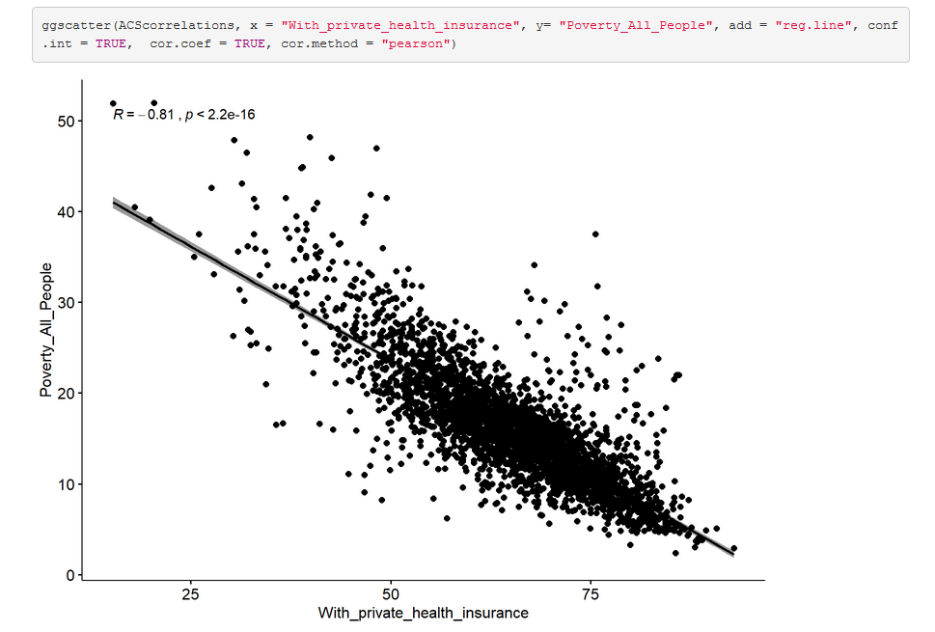
Predicting the Poverty Rate
Charlie Gardner
MSDS 692 Final Project

Slide 2
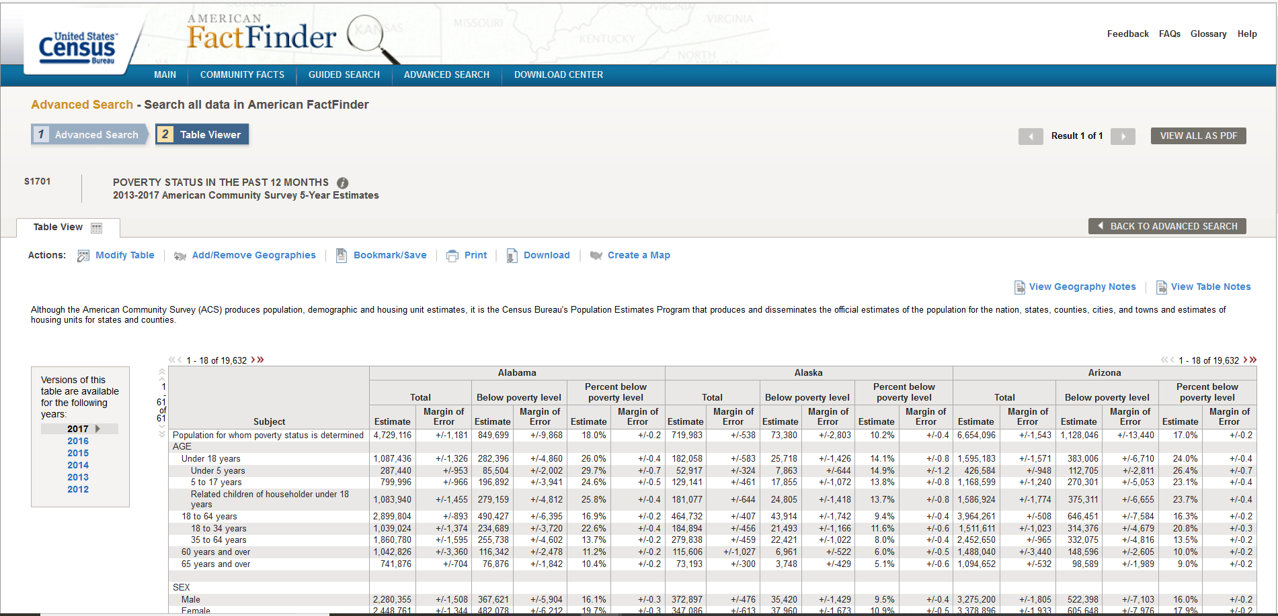
Is it possible to predict the Poverty Rate without Income Levels?
Each year, U.S. Census performs collects demographic data, but surveys do not always have enough information to report on the Poverty Rate for different geographic locations.
Is it possible to accurately predict the poverty rate for different geographies (i.e. states and counties) using other demographic data?

Slide 3
Project plan/overview
Explore the data from the U.S. Census’ American Community Survey (ACS-5yr)
  Download from American Fact Finder: https://factfinder.census.gov
Find strongest correlations between the poverty rate and other variables
  Principle Component Analysis
  Correlation Matrix
Create a regression model from correlated variables to predict the Poverty Rate
  Single Linear Regression
  Multiple Linear Regression
  You can access my project at: https://github.com/4charliegardner/msds692_final_project

Slide 4
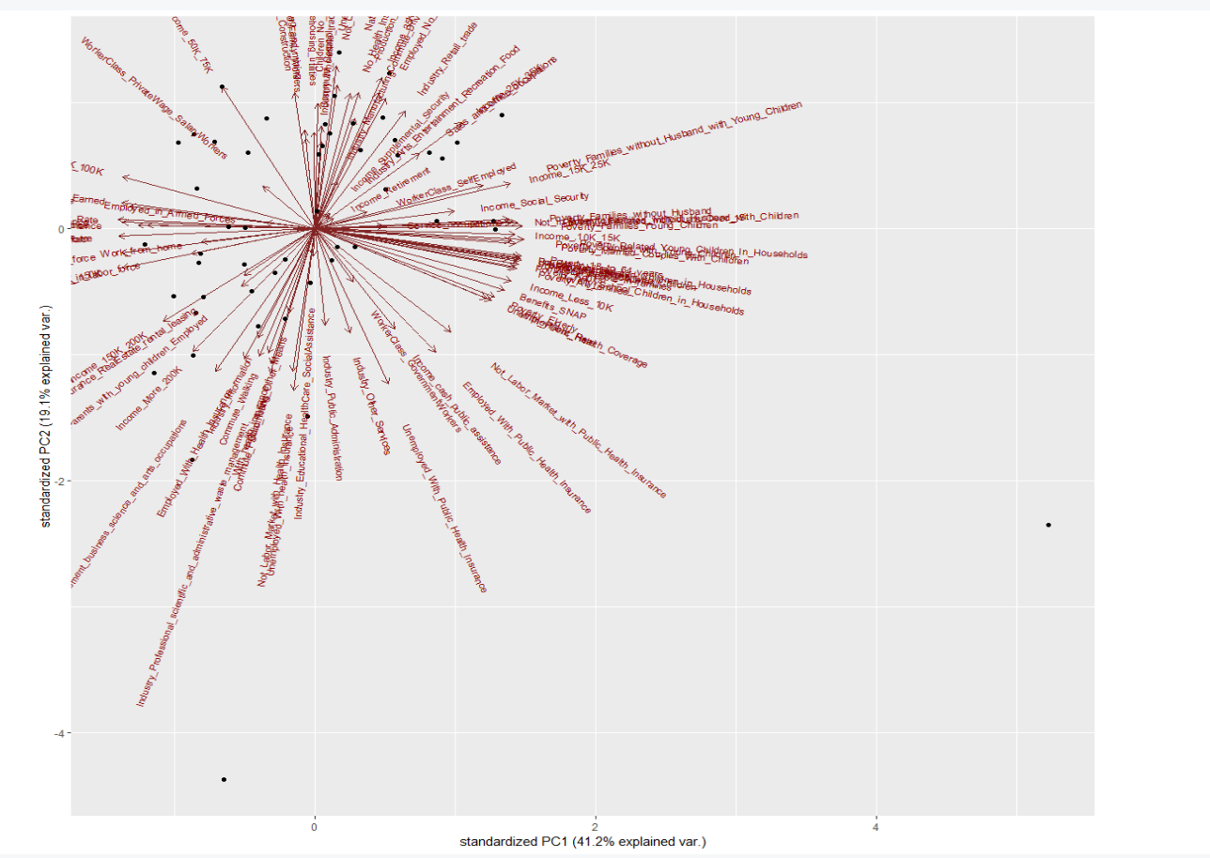
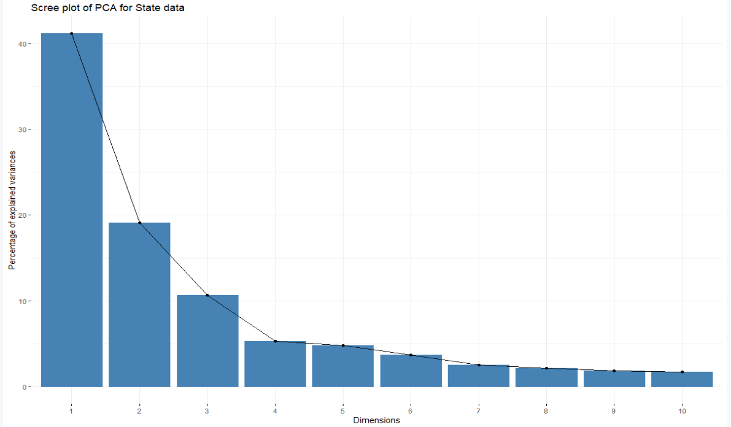
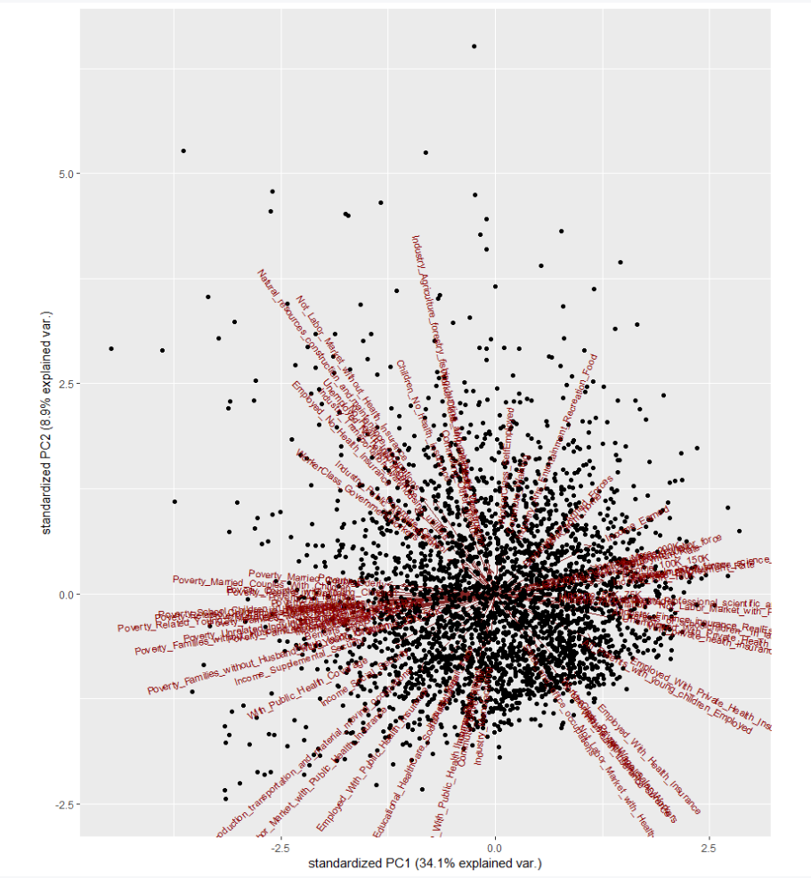
EDA/Principle Component Analysis
What is PCA?
  Reduces multi-dimensional datasets.
  Transforms datapoints, but keeps variance
  Tool to visualize dataset in few dimensions

Slide 5
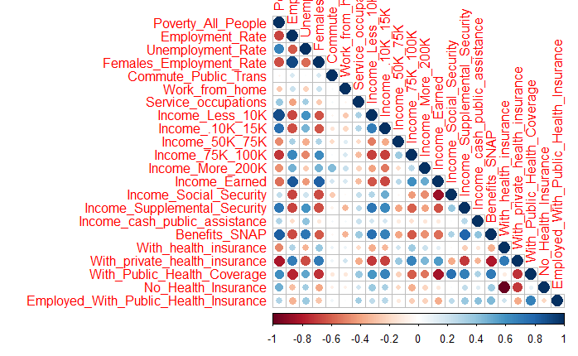
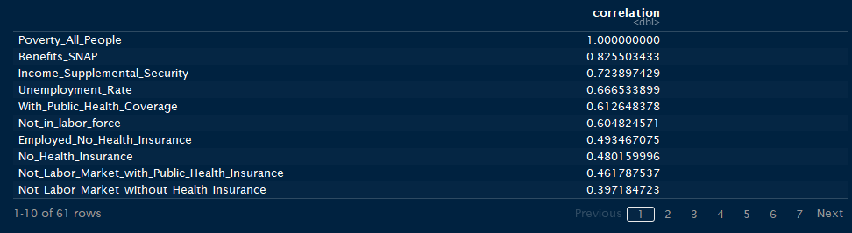
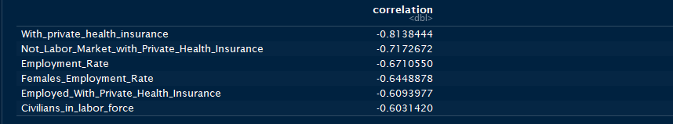
EDA/Correlation Analysis
Correlation Analysis allow us to measure
the relationship between variables.
Strongest correlation as approaching +/- 1
Correlation != Causation
Notes:
The strongly correlated variables are often associated with recieving income or not recieving income. If you are employed, you are less likely to live in poverty. But correlation does not mean causation. Recieving SNAP benefits does not make you impoverished, rather you are more likely to recieve that benefit if you are low incomed. Many of the non-job related variables have a very low correlation or non at all, such as commuting on Public Transportation. Even though we will be excluding for the linear modelling, it is interesting to see that the income levels were not the strongest correlated variables.

Slide 6
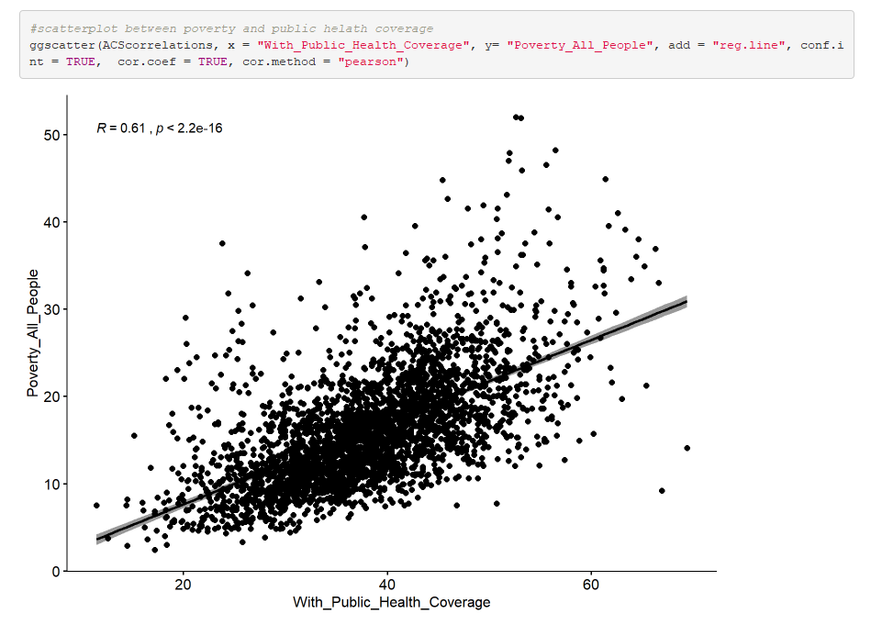
EDA/Correlation Analysis
Notes:
The most unexpected results is that recieving private health insurance has a very strong negative correlation to poverty. But thIs makes sense, because having private health care is an indicator that not only do you have a job, but a good job that provides it as a benefit or provides enough income for you to purchase it.
#A question for further explanation: if private health insurance is a very strong indicator that one does not live under the poverty rate, why isn't having public health insurance as strongly positively correlated with poverty? Two possibilities are that public health coverage does not reach everyone in need. Or that public health coverage actually helps lift peopel out of poverty. Or it could be combination of the both.

Slide 7
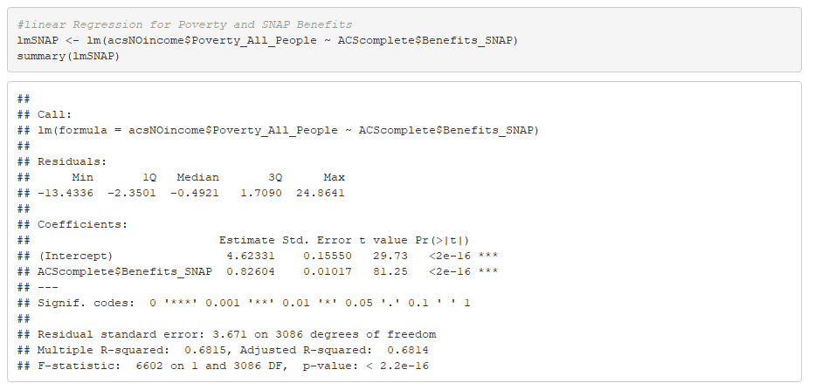
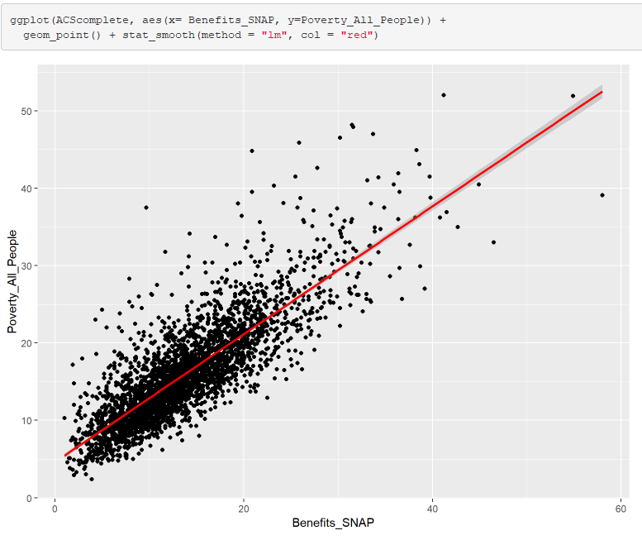
Analysis/Linear Modelling
y = x(coef) + y_intercept
Poverty Rate = x(.82504) + 4.62331;
where x = the percentage of persons receiving SNAP benefits.
If 14.4% of people receive SNAP in a geography, then:
Poverty Rate = 14.4(.82504) + 4.62332
Poverty Rate = 16.5%.

Slide 8
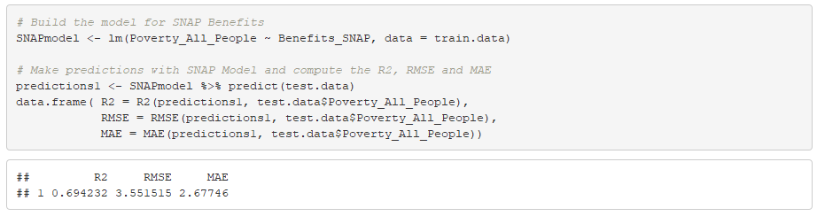
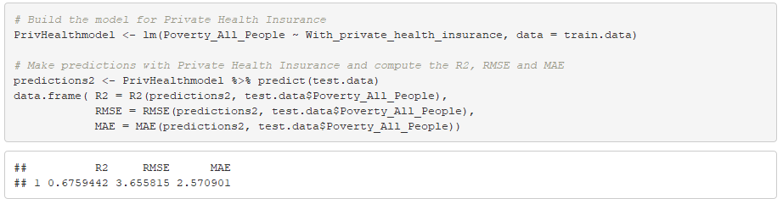
Analysis/Testing Linear Models
Measure LM’s prediction accuracy with new data
Partition dataset into two segments.
When comparing Models:
- R2 (the higher the better)
- RMSE (the lower the better)
- MAE (the lower the better)
Prediction Error:
SNAP LM = 22.2%
Private Healthcare LM = 22.8%
SNAP is a slightly better predictor
Testing Linear Model for SNAP Benefits
Testing Linear Model for Private Health Insurance
Notes:
Testing Linear Models
#While it is good to have linear models for data that we already have, we will eventually need to use the model to predict new data. We can use cross-validation to measure how well a model perform in predicting data it has not yet seen. To do this, we can divide the data we have into two segments: one for training the model and the other for testing it.
#When evaluating the predictions, we look at the R2 (the higher the better), RMSE (the lower the better), and MAE (the lower the better). We can also caculuate the prediction error rate by dividing the RMSE by the average value of the outcome variable (and obviously the smaller the better).
#Even though Snap Benefits had a higher correlation, the linear model created from Private Healthcare is comparable since they altnerate better scores when assessing the R-Squared, Root Mean Squared Error, and Mean Absolute Error values. And the prediction error is basically the same.
### In terms of linear models, either Having Private Health Insurance or Snap Benefits could serve as a good indicator and predictor for the poverty rate.

Slide 9
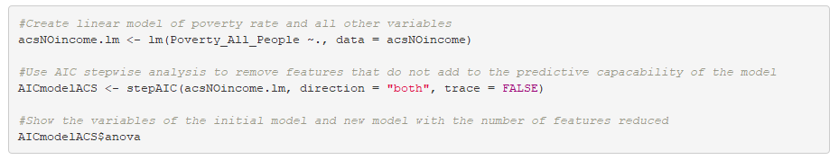
Analysis/StepAIC Analysis
What is StepAIC?
  Reduces multi-dimensional datasets
  Removes features
  Difficult to visualize but creates multi-linear regressions
For stepAIC created a model with 40 features (it removed 21).
Creating stepAIC Model
Viewing stepAIC Model
To use this model to calculate/predict the poverty rate, you would use the same basic principle as a single regression:
  Poverty Rate = y_intercept + x(coefficient of x) + z(coefficient of z)...
Each prediction would require all explanatory variables, otherwise model cannot calculate the dependent variable.
Notes:
StepAIC reduces the dimensions of a dataset by removing features. This makes it more difficult to represent in a plot, but is more useful in creating a linear model to make predictions.
Opposite of PCA.
###To use this model to calcuate/predict the poverty rate, you would use the same basic princple as a single regression.
### Poverty Rate = y-intercept + x(coefficient of x) + z(coefficeint of z)....
###Each prediction would require each explanitory variable, otherise you can not caclulate the y variable.

Slide 10
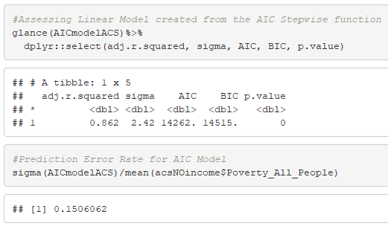
Comparing Models
Testing the stepAIC model
Prediction Error for Linear Models:
SNAP LM = 22.2%
Private Healthcare LM = 22.8%
Testing Linear Model for SNAP Benefits
Testing Linear Model for Private Health Insurance

Slide 11
Conclusions/Which is the best model?
The StepAIC model is the more accurate predictor.
- Higher R-Squared (R2) value,
- Lower Root Mean Squared Error (RMSE) value,
- Prediction error rate of only 15%
But the stepAIC’s multi-regression model is very complex and difficult to visualize.
The single linear models are much simpler and do a strong job of predicting the poverty rate.
In either case, it is possible to predict the poverty rate of different geographies based upon different demographics, even if you don't have income levels data.
Notes:
After comparing the linear models for Private Health Care (the best single line regression) and the multi-line regression model created with AIC, it is clear that the stepAIC model is a more accurate predictor. It has a higher R2 value, a lower RMSE value, and a prediction error rate of only 15% compared to 23% error rate of the Private Health Insurance and 22% error rate for SNAP Benefits Linear model
But even though AIC prevents over-fitting of a model, the multi-regression model is very complex and difficult to visualize in 2 dimensions. Overall, the linear model of Private Health Insurance does a strong job of predicting the poverty rate on its own.
In either case, it is possible to predict the poverty rate of different geographies based upon different demographics, even if you don't have income levels data.

